Slide 1
Alec’s Boardroom

Slide 2
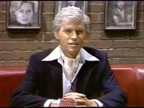
Fernando
“It’s better to look good
than to be good”
Fernando is very critical and judgemental of people. He enjoys mocking others for their appearance, behaviour, opinions, or choices. He has a narrow world-view and does not tolerate diversity or change.
Key Message - Don’t worry about what other’s think .
Biggest Fear - Not conforming to norms
Biggest Threat to me -

Slide 3
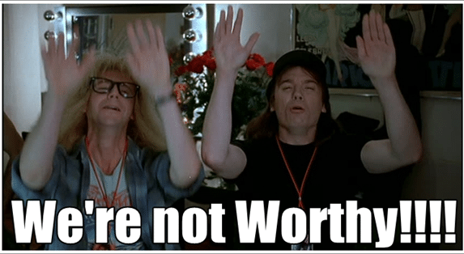
Wayne
“You’re not worthy”
Fears being exposed as a fraud. Success so far has been determined by luck, timing, and deceiving others into thinking he’s more competent than he actually is. Doubts skills and talents, or accomplishments and does not deserve their success.
Key Message - You are worthy
Biggest Fear - Being found out
Biggest Threat to me - Not taking chances

Slide 4
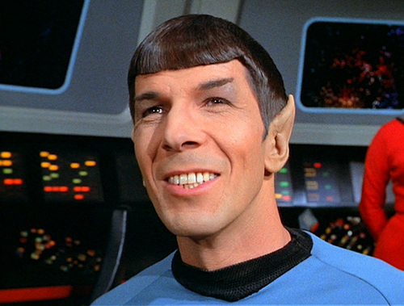
Spock
“Logically…”
Sets a very high standard for logical analysis and limited mistakes. Does not tolerate mistakes or inconsistencies
Main Message - Just enough analysis
Biggest Fear - Having an incorrect assessment or recommendation
Biggest Threat to me - over analyzing situations

Slide 5
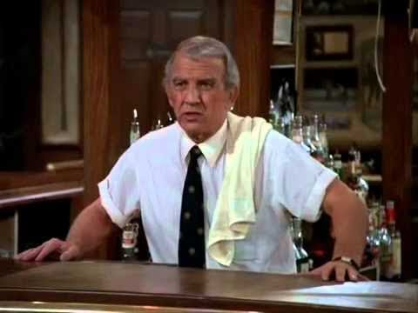
Ernie
“You can do it!”
Looks for ways to improve performance. Looks at building foundational skills, learning tactics for a given scenario, visualizing what success looks like.
Main Message - Become the best version of yourself you can.
Biggest Fear - Failure due to lack of practice
Biggest Threat to me - Setting high expectations

Slide 6
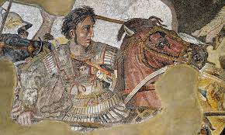
Alexander
“We’re going that way”
Paints a compelling vision for the future as well as the strategy and tactics in how to get there. Leads from the front and is working to make everyone sound him more successful.
Main Message - We’re in this together
Biggest Fear - Looking behind and having no followers
Biggest Threat to me - Choosing the wrong moment to take the leadership position.

Slide 7
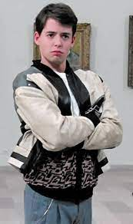
Ferris
“Don’t need to do that now”
Puts things off until the last minute or decides other things are more important. Participates in trivial or non-important activities vs. more important things.
Main Message - Get it done!
Biggest Fear - Not completing something important to myself or others.
Biggest Threat to me - Not re-negotiating commitments

Slide 8
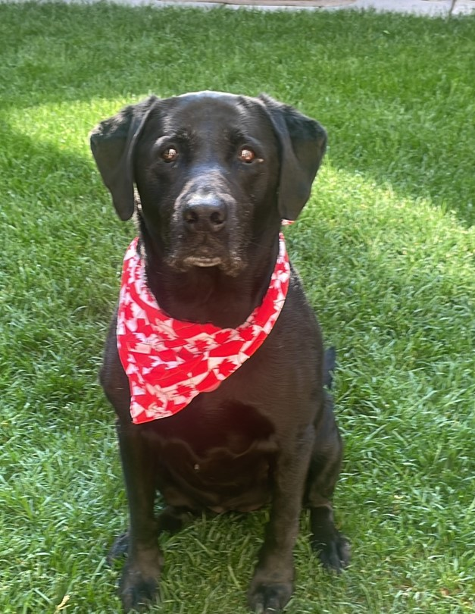
Lacey
“Live and Love in the moment”
Be excited for all of the small things. Going for a walk, chasing a ball, eating a meal. Make sure you wag your tail so that everyone else knows you’re excited.
Main Message - Enjoy life!
Biggest Fear - I don’t have people to play with me.
Biggest Threat to me - Not appreciating the small moments.

